Slide 1
Circuits and Circuit Elements
Holt Chapter 18
Series, Parallel and Complex Circuits

Slide 2
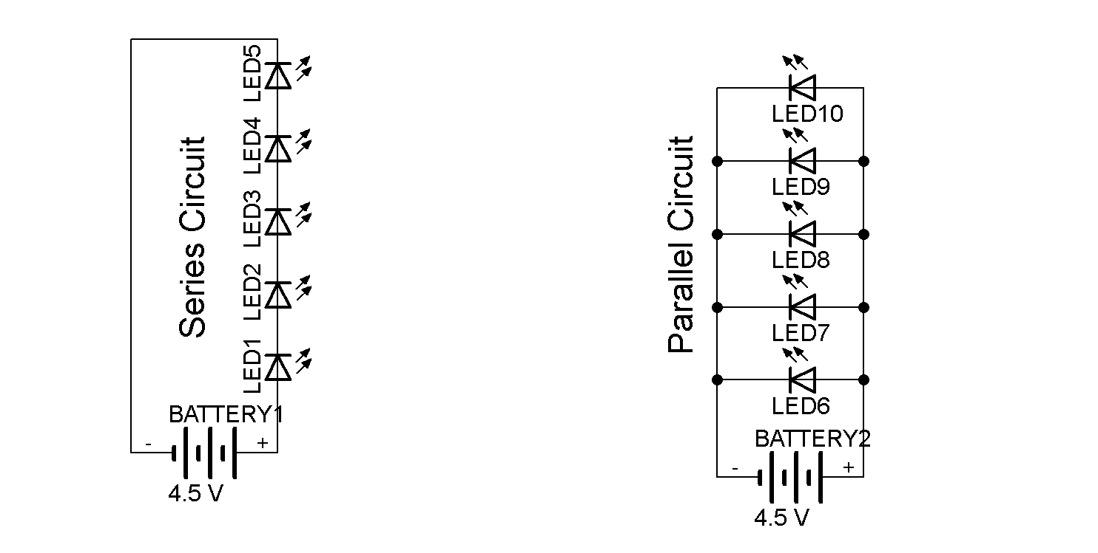
Schematic Diagrams and Circuits
Holt Chapter 18 Section 1

Slide 3
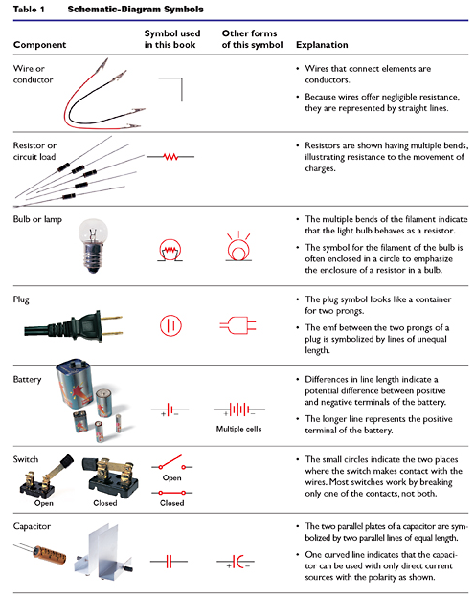
Schematic Diagrams
“In the electrical industry, a schematic diagram is often used to describe the design of equipment. Schematic diagrams are often used for the maintenance and repair of electronic and electromechanical systems. Original schematics were done by hand, using standardized templates or pre-printed adhesive symbols, but today Electrical CAD software is often used.”
-- Wikipedia 4/7/2011
The symbols used in schematic diagrams are relatively standardized
  slightly differing versions may be used in different contexts or countries
Schematics help to simplify a circuit down to its connections, so that it can be more easily designed and analyzed
Eagle is an award-winning schematic Electrical CAD program by CADsoft

Slide 4
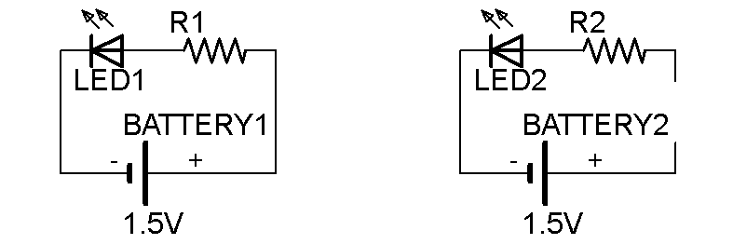
Electric Circuits
An electric circuit is a path through which charges can be conducted.
A load is any element in a circuit that dissipates energy (eg battery, resistor, bulb). Wires have negligible resistance so we will not classify them as a load

Slide 5
Closed and Open Circuits
In a closed circuit there is a closed-loop path for electrons to follow. A closed circuit must be present for continuous current to exist.
In an open circuit there is not a complete path and therefore no charge flow nor current.

Slide 6
Sources of EMF
The source that maintains the current in a closed circuit is called a source of EMF (electromotive force)
  Any devices that increase the potential energy of charges circulating in circuits are sources of EMF
  Examples include batteries and generators
  These are the things that act as a “water pump” in the water analogy for electricity

Slide 7
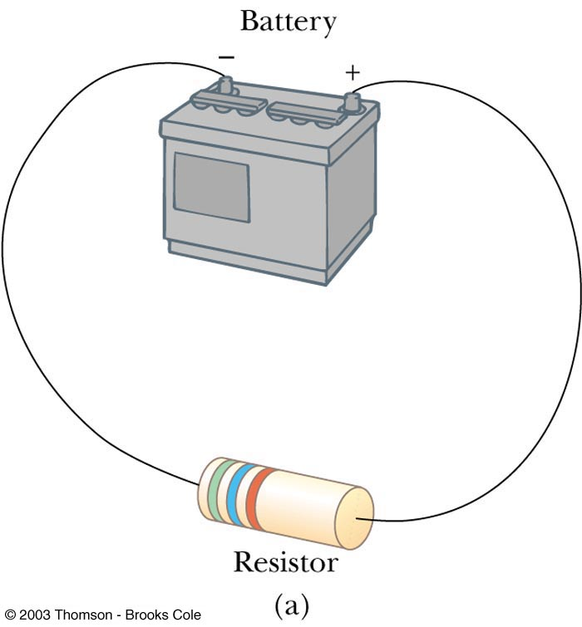
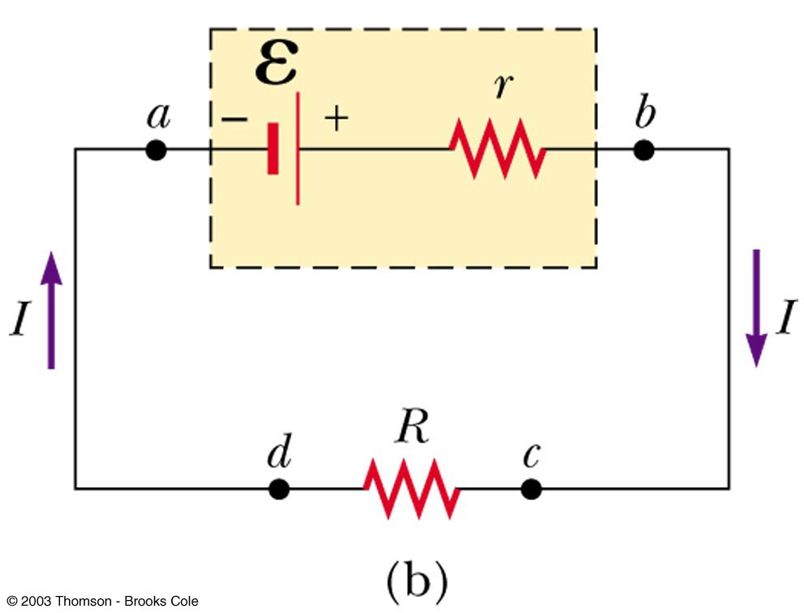
emf and Internal Resistance
A real battery has some internal resistance
Therefore, the terminal voltage is not equal to the emf

Slide 8
More About Internal Resistance
This schematic shows:
  Internal resistance (r)
  Terminal voltage (ΔV = V_{b}-V_{a})
The voltage of the battery is less than the EMF because of internal resistance (r)
The voltage and current on the load (R) are based on the whole battery

Slide 9
Resistors in Series or in Parallel
Holt Chapter 18 Section 2

Slide 10
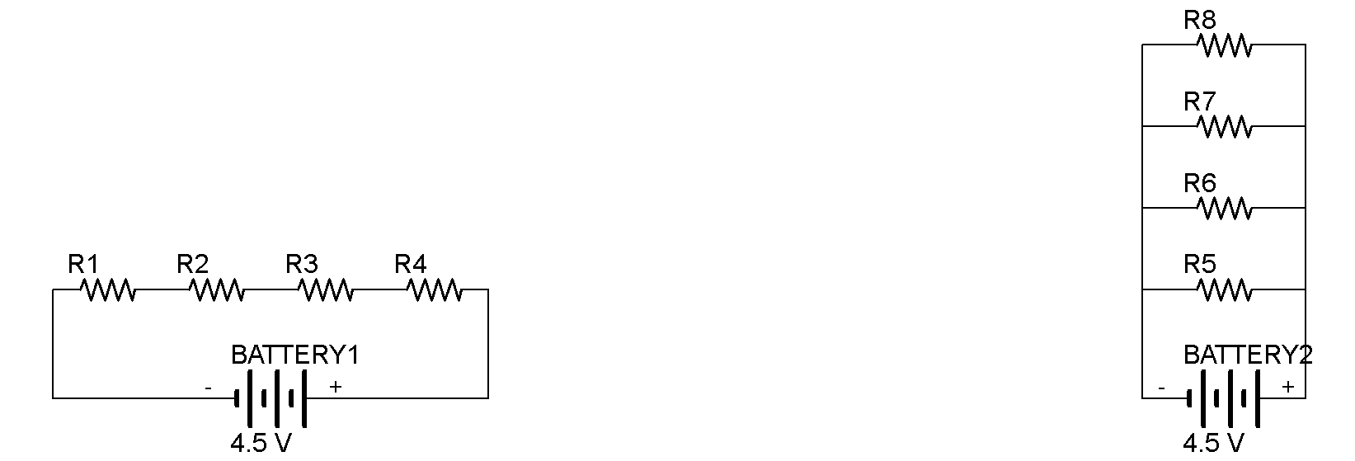
Resistors in Series
When two or more resistors are connected end-to-end, they are said to be in series
The current is the same in resistors because any charge that flows through one resistor flows through the other
The sum of the potential differences across the resistors is equal to the total potential difference across the combination

Slide 11
Resistors in Parallel
Analogy: Students leaving an assembly
  Circuit paths : charges :: open doors : students
Several resistors are connected together in such a way that they are all alternate paths for current to flow though in a circuit
  The potential difference across each resistor is the same because each has the same beginning and ending voltage
  The current in one path is based on the resistance of that path, and so each leg can be different
  The current of all the paths must add up to the current before the parallel split

Slide 12
Comparison of Series and Parallel
Series Resistor Groups
Parallel Resistor Groups
Electric charge must flow sequentially through all of the resistors
  Current is the same in all of the resistors
The voltage of the group is broken-up for each resistor in the group
  All resistors have a different voltage drop (that adds up to total the voltage drop of the group
Electric charge breaks-up through all of the resistors
  Current is different in all of the resistors (*except identical Ω)
The voltage of the group is applied equally to all resistors in the group
  The voltage applied to the group is the same for all resistor s in the group

Slide 13
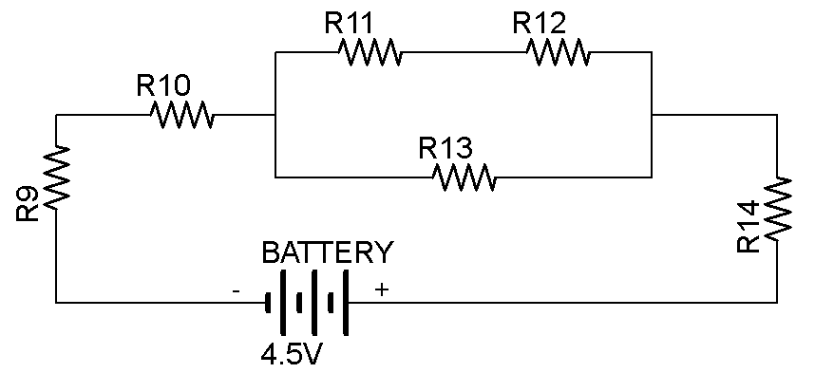
Complex Resistor Combinations
Holt Chapter 18 Section 3

Slide 14
Comparison of Series and Parallel
Series Resistor Groups
Parallel Resistor Groups
Current is the same in all
Voltages can be different for all, based on resistance
  Voltage for group should add up to the battery (or special)
  Load volts = - Battery volts
Voltage is the same for all
Current can be different for all, based on resistance
  Current for all paths should add up to current before the split (the Junction Rule)

Slide 15
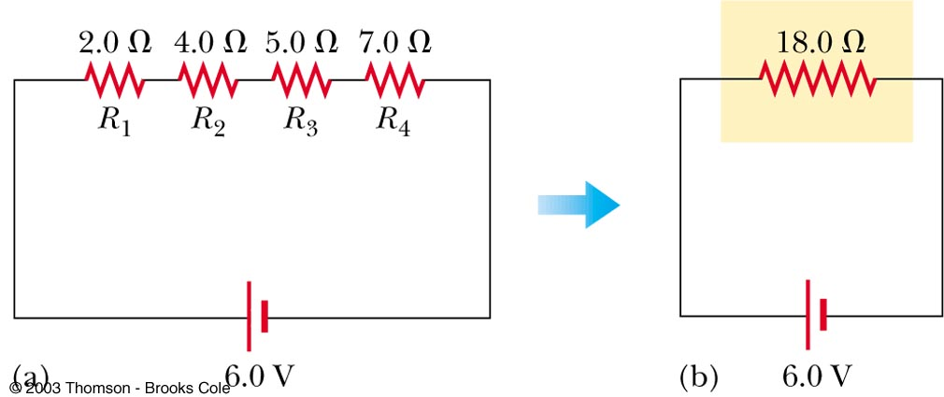
Equivalent Resistance – Series
R_{eq} = R₁ + R₂ + R₃ + …
  The equivalent resistance of a series of resistors is the sum of the individuals and is always greater than any of the individual resistances
Find the voltage drop for any resistor by using Ohm’s Law (V=IR)
The sum of the voltage drops for all resistors in the series will be the same as the EMF

Slide 16
Series Circuit Questions
Four resistors are connected in series. Their resistances are 5Ω, 15Ω, 25Ω and 50Ω. What is their equivalent resistance?
A. If they are attached to a 50V battery, what is the current?
B. What is the current in the 15Ω resistor?
C. What is the voltage drop of the 25Ω resistor?
D. What is the voltage drop for each resistor?
E. What is the power used by the 25Ω resistor?
95Ω 0.526Amps 0.526Amps 13.1V 6.86W

Slide 17
Ex. 1
A 5 ohm, 10 ohm, and 15 ohm resistor are connected in series.
  Which resistor has the most current in it?
  Which resistor has the largest potential difference?
  What is the equivalent (or total) resistance of the circuit?

Slide 18
Ex. 2
Find the current and potential difference across each of the resistors in the following circuits:
  A 2 ohm and a 4 ohm resistor wired in series with a 12V source
  A 4 ohm and a 12 ohm resistor wired in series with a 12V source
  A 150 ohm and a 180 ohm resistor wired in series with a 12V source

Slide 19
Equivalent Resistance – Parallel, Examples
Equivalent resistance replaces the two original resistances
Household circuits are wired so the electrical devices are connected in parallel
  Circuit breakers may be used in series with other circuit elements for safety purposes

Slide 20
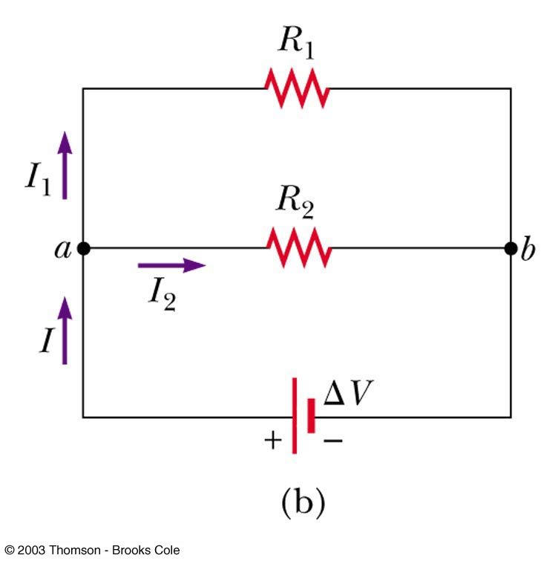
Equivalent Resistance – Parallel
Equivalent Resistance
equivalent resistance for parallel resistors is always less than the smallest resistor in the group

Slide 21
Kirchoff’s Law (Junction Rule)
Kirchoff’s Law: The current (I) that enters a point must be equal to the total current leaving that point
  I = I₁ + I₂
  The currents are generally not the same in all parallel paths
  The charges will “exit the auditorium” so that they can get through the doors but, if not all doors have the same resistance, the lower resistance doors will have more traffic

Slide 22
Parallel Circuit Questions
Four resistors are connected in parallel. Their resistances are 5Ω, 15Ω, 25Ω and 50Ω. What is their equivalent resistance?
If they are attached to a 9V battery, what is the current?
What is the current in the 15Ω resistor?
What is the current in each resistor?
What is the voltage drop of the 25Ω resistor?
3.06Ω 2.94Amps 0.6Amps 9V

Slide 23
Ex. 3
Find the current and potential difference across each of the resistors in the following circuits:
  A 12 ohm and a 4 ohm resistor wired in parallel with a 12V source
  A 4 ohm and a 12 ohm resistor wired in series with a 12V source

Slide 24
Ex. 4
Find the equivalent resistance, the current in each resistor, and the current drawn by the circuit load for a 9.0V battery connected in parallel to the following resistors.
A) two 30 ohm resistors
B) three 30 ohm resistors
C) five 30 ohm resistors

Slide 25
Ex. 5
Sketch as many different circuits as possible involving a battery and three bulbs of equal resistance.
How many different circuits would exist with four bulbs?

Slide 26
Comparison of Series and Parallel
Series Resistor Groups
Parallel Resistor Groups
Current is the same in all
Voltages can be different for all, based on resistance
  Voltage for group should add up to the battery (or special)
  Load volts = - Battery volts
Voltage is the same for all
Current can be different for all, based on resistance
  Current for all paths should add up to current before the split (the Junction Rule)

Slide 27
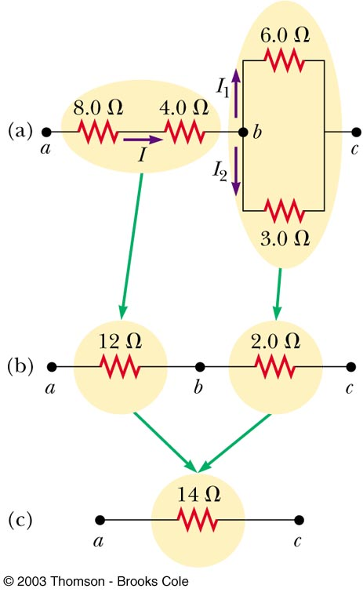
Analysis Strategy for Resistors Combined both in Parallel and Series
Any resistor circuit can be systematically simplified down to just one equivalent resistor
  Simplify all parallel bundles into their equivalent resistors
      Track all intermediates
  Simplify all series resistors into the single equivalent
  Find the current through the equivalent resistor
  Tease the voltages out through the current of the series
  Find the currents in parallel bundles through the voltages

Slide 28
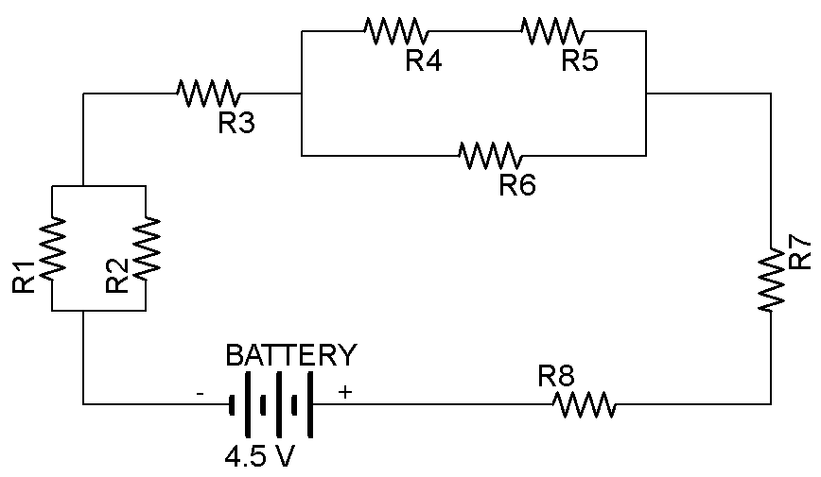
Let’s start an example with this complex circuit
Take a careful look at this circuit. We will first make a small change to get started…

Slide 29
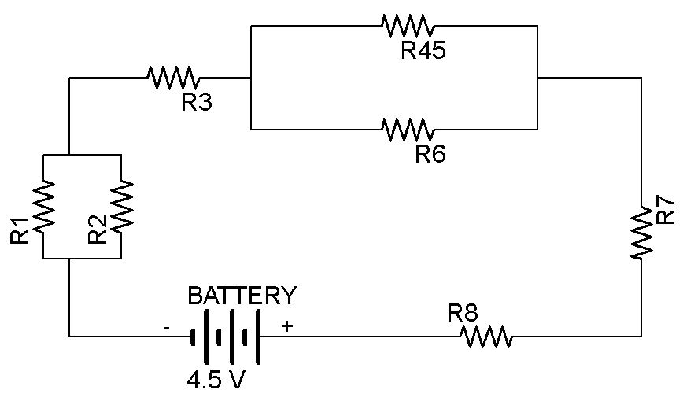
1. Simplify all parallel bundles into their equivalent resistors
This will reduce it to a simple series circuit

Slide 30
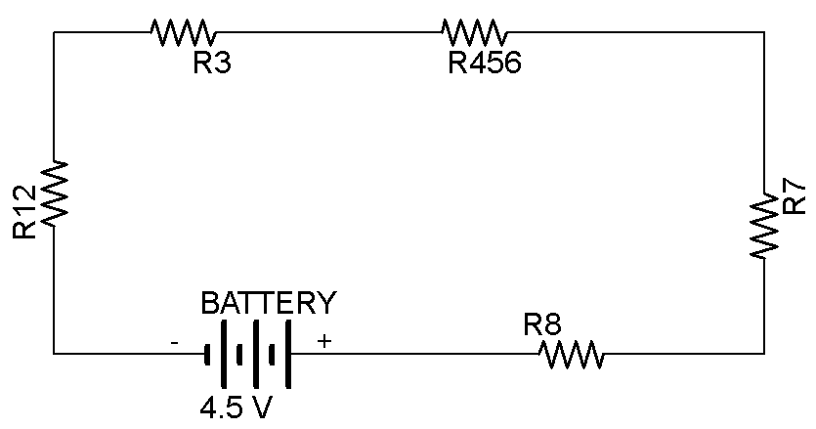
2. Simplify all series resistors into their single equivalent resistor
We could redraw this for the sake of simplicity…

Slide 31
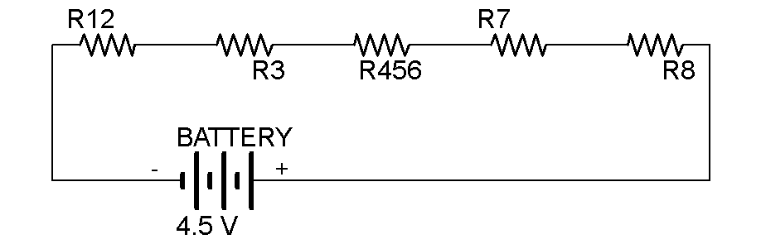
2. Simplify all series resistors into their single equivalent resistor
From there we can find our overall current

Slide 32
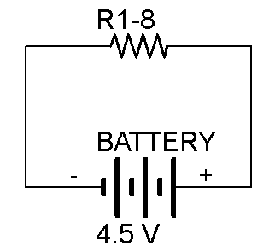
3. Find the current through the single equivalent resistor
V=IR

Slide 33
4. Tease out the voltages through the current of the series of resistors
V=IR for every last one of these resistors (real or imaginary)

Slide 34
5. Find the currents in parallels based on the voltages found in series
I=V_{eq}/R when you consider the parallel groups

Slide 35
5. Find the currents in parallels based on the voltages found in series
Follow the process though to completion…
There are some circuits that are too complex for this method, outside the scope of this course.

Slide 36
Simplifying Complex Circuits
An example of simplifying a complex circuit as you might see in a technical diagram. Courtesy of: http://www.allaboutcircuits.com/

Slide 37
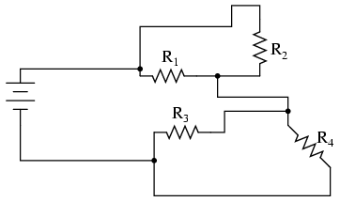
Simplifying a Complex Circuit
Take a good look at the circuit when you start
Images courtesy of: http://www.allaboutcircuits.com/

Slide 38
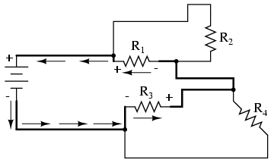
Simplifying a Complex Circuit
Find the shortest path around the circuit from one battery terminal to the next
Images courtesy of: http://www.allaboutcircuits.com/

Slide 39
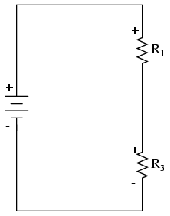
Simplifying a Complex Circuit
Redraw this loop so that you can organize your thoughts
Images courtesy of: http://www.allaboutcircuits.com/

Slide 40
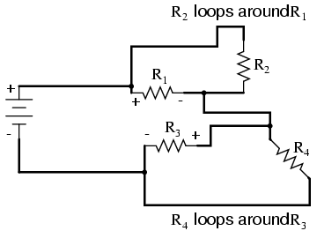
Simplifying a Complex Circuit
Look for the loops around the components in the simplest loop (that you just found)
Images courtesy of: http://www.allaboutcircuits.com/

Slide 41
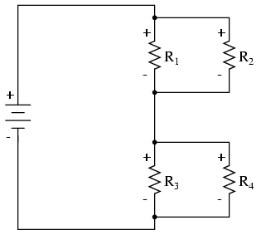
Simplifying a Complex Circuit
Recreate these loops in your simplified redrawing of the circuit
Images courtesy of: http://www.allaboutcircuits.com/

Slide 42
Quick Quiz Questions
On your toes…

Slide 43
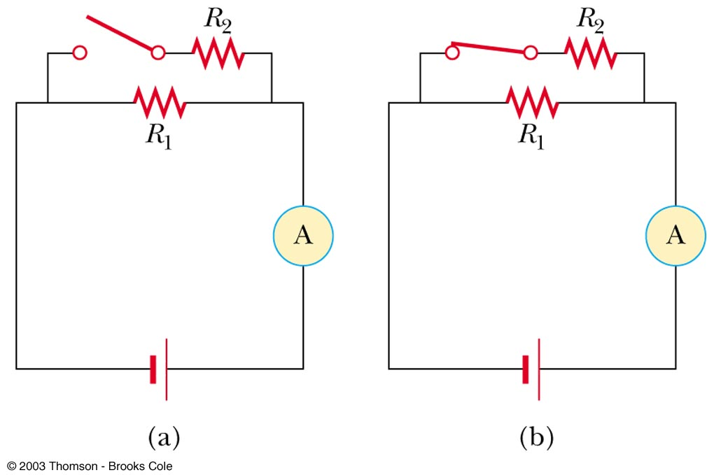
Quick Quiz 18.3
With the switch in this circuit (figure a) open, there is no current in R₂. There is current in R₁ and this current is measured with the ammeter at the right side of the circuit.
If the switch is closed (figure b), there is current in R₂. When the switch is closed, the reading on the ammeter:
Increases
Decreases
Remains the same
(a) When the switch is closed, resistors R₁ and R₂ are in parallel, so that the total circuit resistance is smaller than when the switch was open. As a result, the total current increases.

Slide 44
QUICK QUIZ 18.4
You have a large supply of light bulbs and a battery. You start with one light bulb connected to the battery and notice its brightness. You then add one light bulb at a time, each new bulb being added in parallel to the previous bulbs. As the light bulbs are added, what happens:
to the brightness of the bulbs?
to the current in the bulbs?
to the power delivered by the battery?
to the lifetime of the battery?
to the terminal voltage of the battery?
Hint: Do not ignore the internal resistance of the battery.
The brightness of the bulbs decreases
The current in the bulbs decreases
The power delivered by the battery increases
The lifetime of the battery decreases
The terminal voltage of the battery decreases

Slide 45
Electrical Safety
Before you try this at home…

Slide 46
Electrical Safety
Electric shock can result in fatal burns
Electric shock can cause the muscles of vital organs (such as the heart) to malfunction
  Since our organs all run on electrical messages from the brain in the first place
The degree of damage depends on
  the magnitude of the current
  the length of time it acts
  the part of the body through which it passes

Slide 47
Effects of Various Currents
5 mA or less
  can cause a sensation of shock
  generally little or no damage
10 mA
  hand muscles contract
  may be unable to let go a of live wire
100 mA
  if passes through the body for 1 second or less, can be fatal

Slide 48
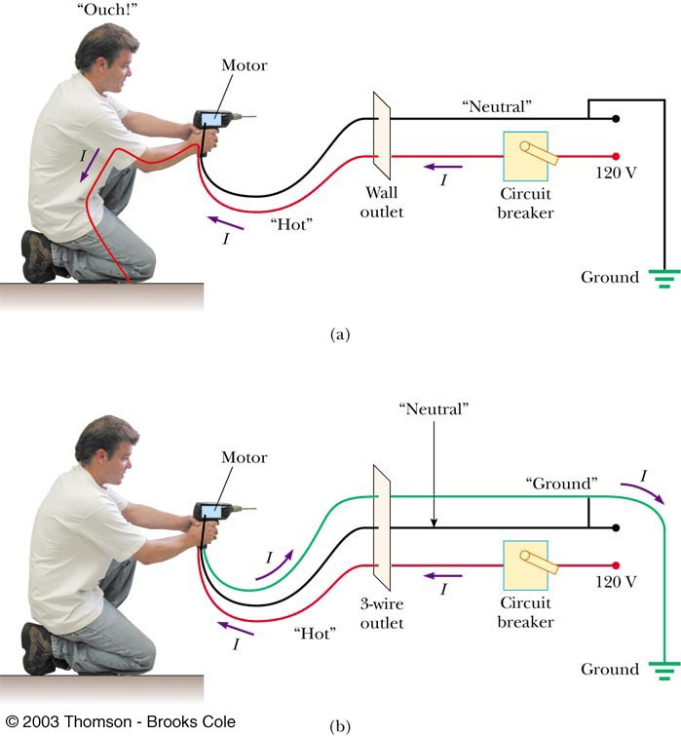
Ground Wire
Electrical equipment manufacturers use electrical cords that have a third wire, called a ground
  Prevents shocks

Slide 49
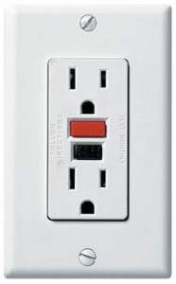
Ground Fault Interrupts (GFI)
Special power outlets
Used in hazardous areas
  Ex: Kitchen, bathroom, laboratory
Designed to protect people from electrical shock
Senses currents (of about 5 mA or greater) leaking to ground
Shuts off the current when above this level

